Slide 1

Citi HackOverFlow 2021
Team 19

Slide 2

Problem Statement
Despite the increasing trend of shopping online due to the Covid-19 pandemic, many Singaporeans still prefer offline shopping.
4 in 10 Singaporeans are not satisfied with online shopping

Slide 3

Problem Statement
One of the most flexible tools for offline shopping are QR codes.
Common uses include being used for payments, as well as to obtain discount vouchers.
It is estimated that by 2022, about 5.3 Billion coupon codes will be redeemed via QR Codes.

Slide 4

Solution
Rationale
1) Higher Usage
People spend more mobile time on apps, compared to websites
Recent research shows that 90% of mobile time is spent on apps and only 10% is spent on the internet.
2) Higher Conversions
Mobile Apps are far better at closing the deal with customers.
Apps have 3x higher conversion rates compared to mobile sites.
Mobile Application
Allows users to purchase and redeem QR codes while shopping

Slide 5
User Interface (Demo)
Time for a video demonstration

Slide 6
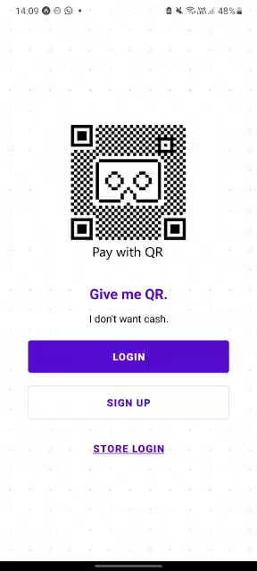
Video Demo
User Login
This is how the app behaves when the user is logged in as a user.
Sign up/ Login
Main screen with highlighted vouchers
Brands screen with all vouchers available sorted by store
Profile screen to see user details, cart items, loyalty points and logout
My Vouchers screen displays all the vouchers purchased by the user and ready for redemption.
Add vouchers to cart > Check out cart > View my vouchers screen > Click on purchased voucher you want to redeem > Generate QR Code
QR Code can be used in app or screenshotted and saved as image to be used offline

Slide 7
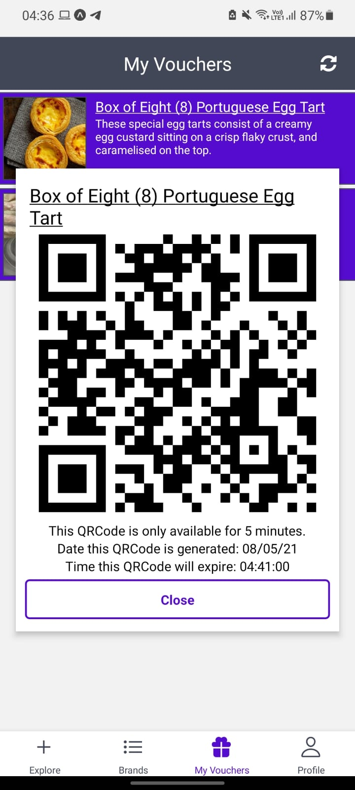
Video Demo
QR Code
This is how the QR Code looks like.
Voucher name
QR Code of voucher
How long the QR Code is valid for
Date of QR Code generated
Time the generated QR Code expires

Slide 8
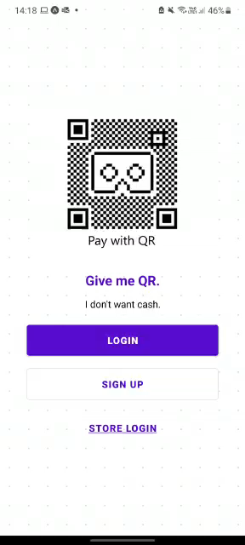
Video Demo
Cashier Login
This is how the app behaves when the user is logged in as a cashier.
Sign up/ Login under store login
Main screen which is scan screen to scan QR Code
If QR code is valid, QR Code will be redeemed. If QR code is expired (past valid datetime), QR Code cannot be redeemed.

Slide 9
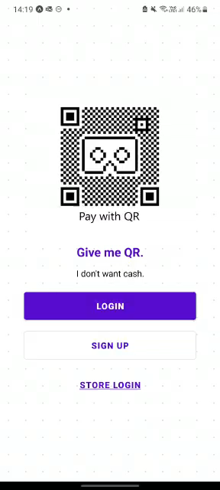
Video Demo
User UI after redeeming voucher
This is how the app behaves after the user redeemed his/her voucher.
The voucher redeemed successfully will be removed from My Vouchers screen.

Slide 10
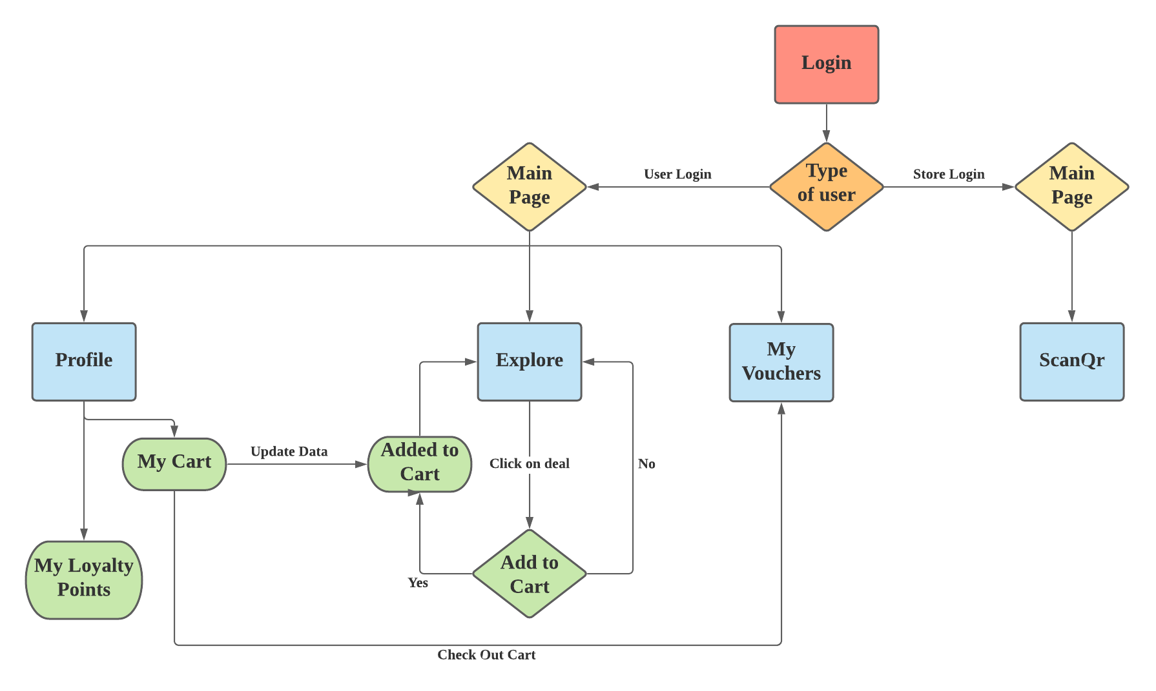
Workflow

Slide 11
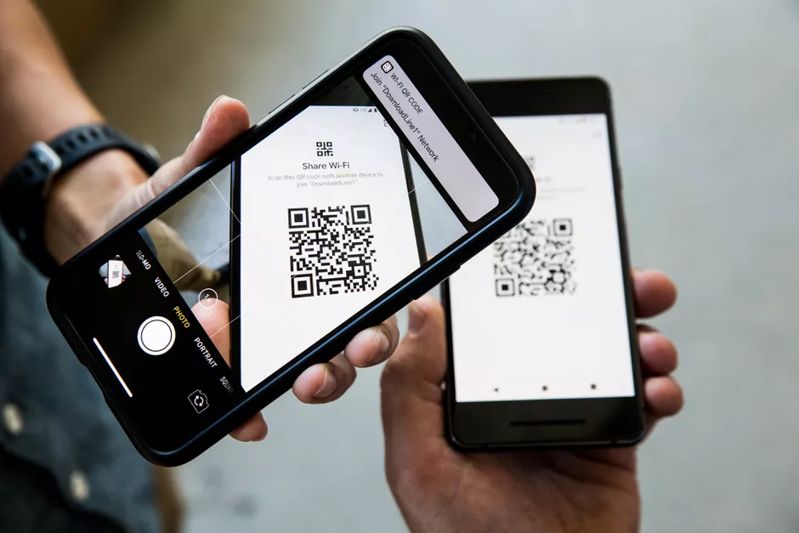

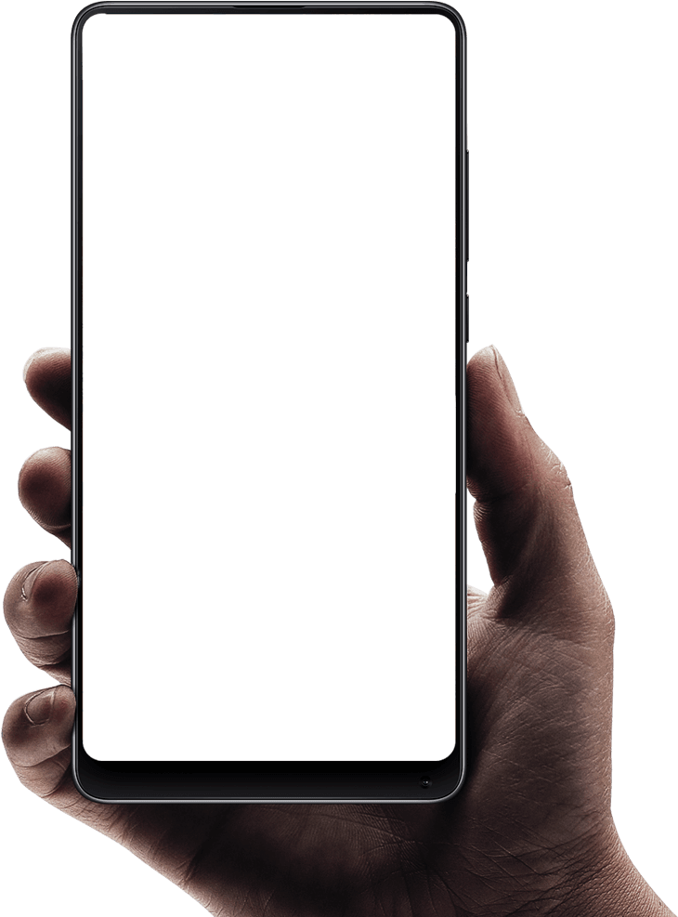
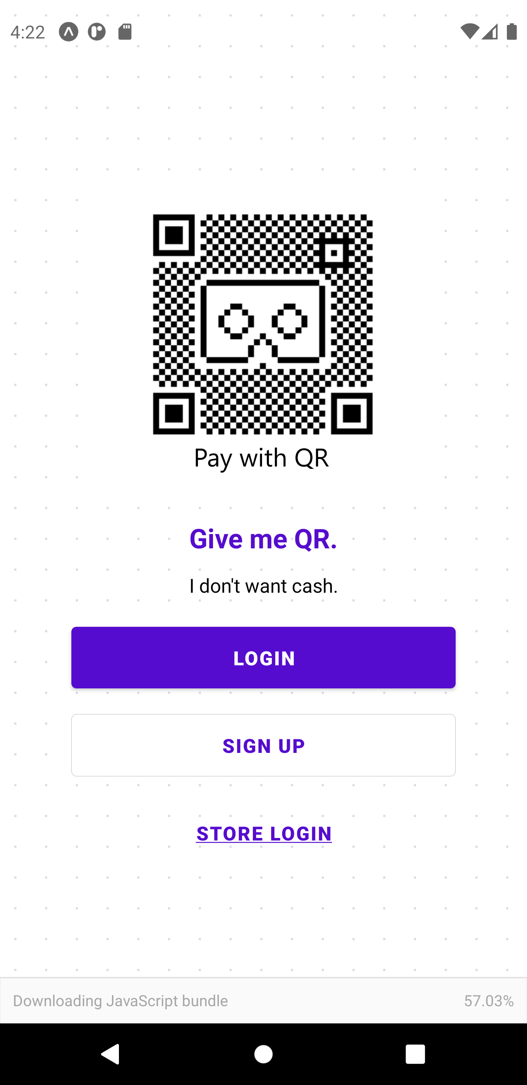
Key Functionalities
User
Cashier
Locate vouchers available for purchase and redemption
Get detailed information on a voucher of user’s choice
Purchase voucher of user’s choice
Generate a unique QR Code for voucher redemption that can be used online and offline
Track loyalty points earned
Scan user’s voucher’s QR Code for quick and easy redemption
Check for validity of QR Code to protect businesses

Slide 12



Additional Features
Security
Time limit on QR codes to avoid reselling
Ease of Use
Easily find vouchers from various brands
Search Options
Search for vouchers or brands in mind
Or
Scan stores' QR code to explore their vouchers

Slide 13



Tech Stack
React Native
Expo
Firebase
Cross Platform App Development (Supports both ios and android)
Compiles to web app as well
Allows the use of existing skills as it is based on Javascript - need less specialized knowledge
Both a framework and a platform that simplifies the creation and deployment of mobile applications with React Native
Quick building and deployment of app
Easy to eject and transform app to vanilla React Native
Owned by Google
Complete package of products from cloud storage to machine learning
Create Application without backend server
Sync real time data in the application

Slide 14
Timeline
Brainstorming
Developing
Presenting
Did extensive research and exchanged ideas
Decided on overall direction for application
Hands on work on developing the design as well as architecture of the app
Unit testing to ensure app runs smoothly
- Preparing for live presentation and demo

Slide 15



Key Metrics
Key Metric | Desired Target
Load Speed | < 10 seconds
Devices | Compatible with all mobile devices
Crash rate | < 1% App crashes per session

Slide 16
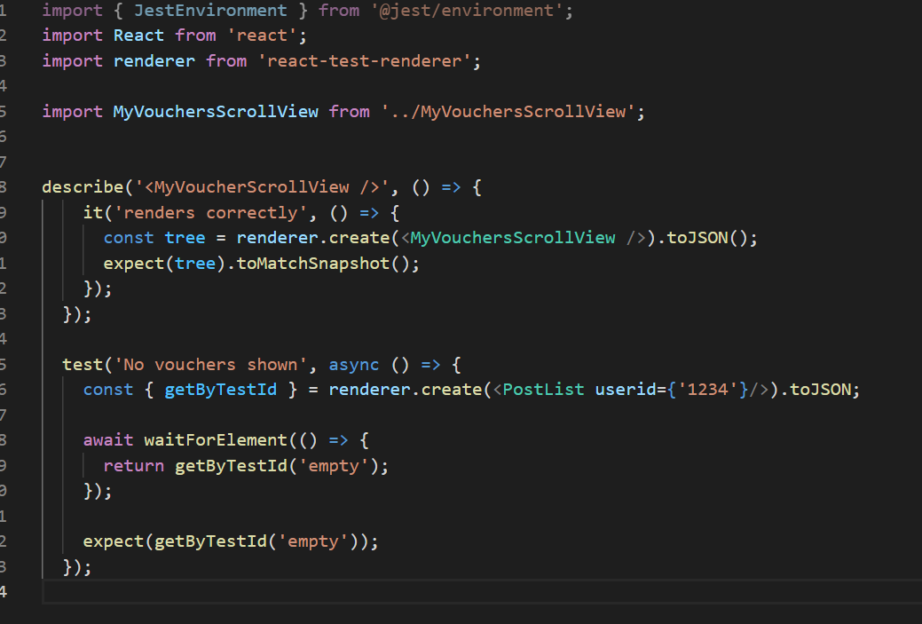
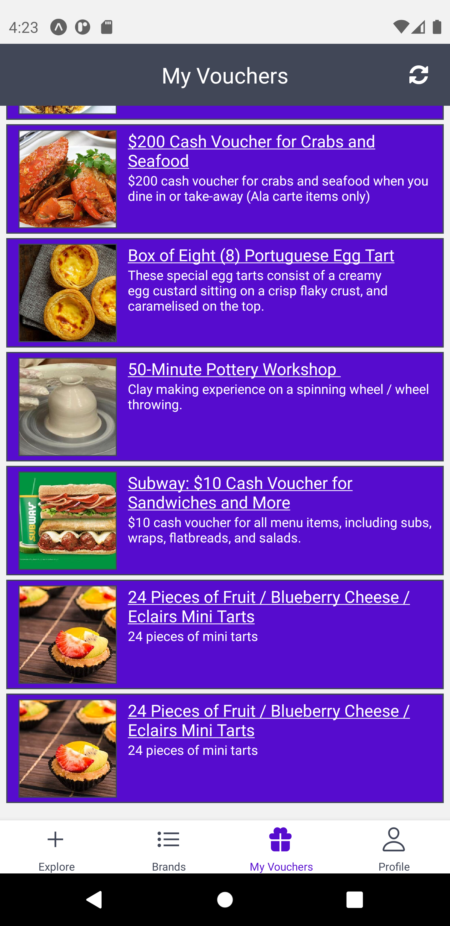
Testing with Jest-expo
Rendering test

Slide 17
Questions
Team 19

